Slide 1
ORACLE SQL Introduction
MTN.NIX.07
ORACLE SQL BASICS,
DML operations
Siarhei Kandrashevich
Senior DB Developer

Slide 2
Objectives
Oracle Data Manipulation Language (DML)
INSERT
UPDATE
DELETE

Slide 3
Oracle Data Manipulation Language (DML)

Slide 4
Data modification statements
Data Manipulation Language (DML) besides of the SELECT statement that retrieves information from databases includes also statements modifying data state. These statements are:
INSERT | Inserts rows into database table
UPDATE | Changes values in columns of database table
DELETE | Deletes rows from database table
MERGE | Use the MERGE statement to select rows from one or more sources for update or insertion into a table or view.
LOCK TABLE | Lock tables and views in any schema.
SELECT | Query the view with the SELECT statement.
CALL | Use the CALL statement to execute a routine (a standalone procedure or function, or a procedure or function defined within a type or package) from within SQL.
EXPLAIN PLAN | Use the EXPLAIN PLAN statement to determine the execution plan Oracle Database follows to execute a specified SQL statement.

Slide 5
INSERT
Notes:
Use the INSERT statement to add rows to:
a table,
the base table of a view,
a partition of a partitioned table or a subpartition of a composite-partitioned table,
or an object table or the base table of an object view.
== Mat Views ==
You cannot insert rows into a read-only materialized view.
If you insert rows into a writable materialized view, then the database inserts the rows into the underlying container table. However, the insertions are overwritten at the next refresh operation.
If you insert rows into an updatable materialized view that is part of a materialized view group, then the database also inserts the corresponding rows into the master table.

Slide 6





INSERT single table
single_table_insert ::=
insert_into_clause ::=
values_clause ::=
returning_clause::=

Slide 7

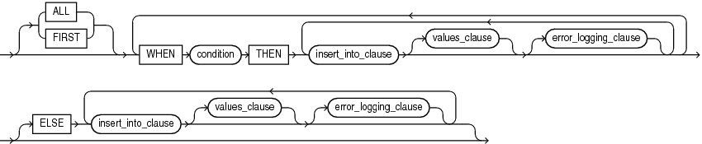
INSERT multi table
multi_table_insert ::=
conditional_insert_clause ::=

Slide 8
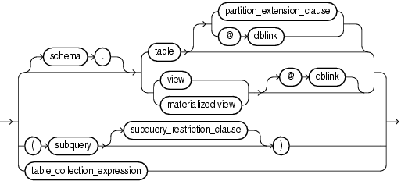


DML expression clause
DML_table_expression_clause::=
subquery_restriction_clause::=
table_collection_expression ::=

Slide 9
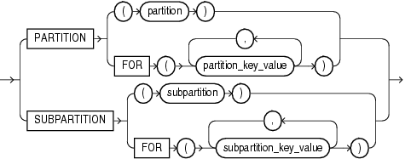
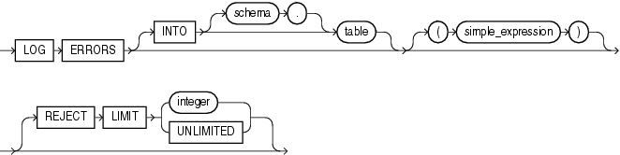
Partition and error logging
partition_extension_clause::=
error_logging_clause ::=

Slide 10
INSERT : Examples
INSERT INTO departments
VALUES (280, 'Recreation', 121, 1700);
INSERT INTO departments
VALUES (280, 'Recreation', DEFAULT, 1700);
INSERT INTO employees (employee_id, last_name, email,
hire_date, job_id, salary, commission_pct)
VALUES (207, 'Gregory', 'pgregory@example.com',
sysdate, 'PU_CLERK', 1.2E3, NULL);
INSERT INTO
(SELECT employee_id, last_name, email, hire_date, job_id,
salary, commission_pct FROM employees)
VALUES (207, 'Gregory', 'pgregory@example.com',
sysdate, 'PU_CLERK', 1.2E3, NULL);

Slide 11
Inserting Values with a Subquery: Examples
INSERT INTO bonuses
SELECT employee_id, salary*1.1
FROM employees
WHERE commission_pct > 0.25;
Subquery

Slide 12
Inserting Into a Table with Error Logging: Examples
CREATE TABLE raises (emp_id NUMBER, sal NUMBER
CONSTRAINT check_sal CHECK(sal > 8000));
EXECUTE DBMS_ERRLOG.CREATE_ERROR_LOG('raises', 'errlog');
INSERT INTO raises
SELECT employee_id, salary*1.1 FROM employees
WHERE commission_pct > .2
LOG ERRORS INTO errlog ('my_bad') REJECT LIMIT 10;
SELECT ORA_ERR_MESG$, ORA_ERR_TAG$, emp_id, sal FROM errlog;
ORA_ERR_MESG$ ORA_ERR_TAG$ EMP_ID SAL
--------------------------- -------------------- ------ ----
ORA-02290: check constraint my_bad 161 7700
(HR.SYS_C004266) violated

Slide 13

Multitable Inserts: Examples
SELECT * FROM sales_input_table;
INSERT ALL
INTO sales (prod_id, cust_id, time_id, amount)
VALUES (product_id, customer_id, weekly_start_date, sales_sun)
INTO sales (prod_id, cust_id, time_id, amount)
VALUES (product_id, customer_id, weekly_start_date+1, sales_mon)
INTO sales (prod_id, cust_id, time_id, amount)
VALUES (product_id, customer_id, weekly_start_date+2, sales_tue)
INTO sales (prod_id, cust_id, time_id, amount)
VALUES (product_id, customer_id, weekly_start_date+3, sales_wed)
INTO sales (prod_id, cust_id, time_id, amount)
VALUES (product_id, customer_id, weekly_start_date+4, sales_thu)
INTO sales (prod_id, cust_id, time_id, amount)
VALUES (product_id, customer_id, weekly_start_date+5, sales_fri)
INTO sales (prod_id, cust_id, time_id, amount)
VALUES (product_id, customer_id, weekly_start_date+6, sales_sat)
SELECT product_id, customer_id, weekly_start_date, sales_sun,
sales_mon, sales_tue, sales_wed, sales_thu, sales_fri, sales_sat
FROM sales_input_table;

Slide 14
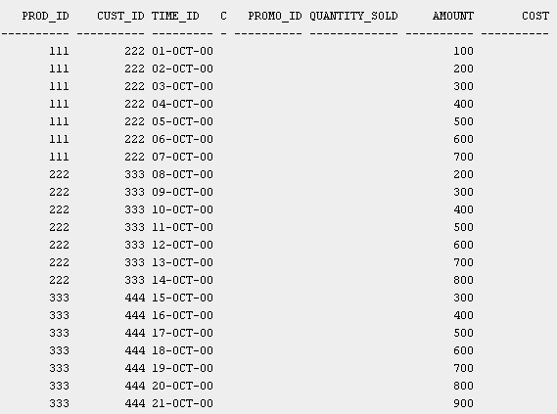
Multitable Inserts: Examples
SELECT * FROM sales ORDER BY prod_id, cust_id, time_id;

Slide 15
UPDATE
Notes:
Use the INSERT statement to add rows to:
a table,
the base table of a view,
a partition of a partitioned table or a subpartition of a composite-partitioned table,
or an object table or the base table of an object view.
== Mat Views ==
You cannot insert rows into a read-only materialized view.
If you insert rows into a writable materialized view, then the database inserts the rows into the underlying container table. However, the insertions are overwritten at the next refresh operation.
If you insert rows into an updatable materialized view that is part of a materialized view group, then the database also inserts the corresponding rows into the master table.

Slide 16
DML UPDATE Statement
Use the UPDATE statement to change existing values in a table or in the base table of a view or the master table of a materialized view.
To update values in a table the table must be in your own schema or you must have the UPDATE object privilege on the table.

Slide 17
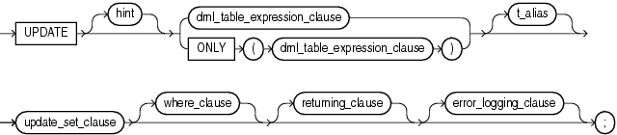
UPDATE Syntax
update::=
DML_table_expression_clause::=

Slide 18
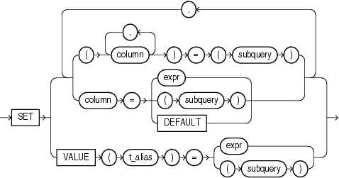
UPDATE Syntax
subquery_restriction_clause ::=
update_set_clause ::=
where_clause ::=
Like WHERE clause
in SELECT statement

Slide 19
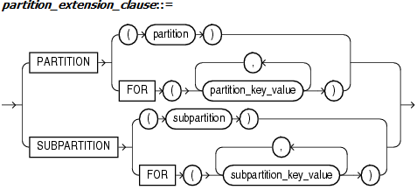
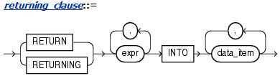

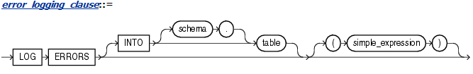
UPDATE Syntax
For partitioned tables
PL/SQL extensions
Notes:
returning_clause
The returning clause retrieves the rows affected by a DML statement. You can specify this clause for tables and materialized views and for views with a single base table.
When operating on a single row, a DML statement with a returning_clause can retrieve column expressions using the affected row, rowid, and REFs to the affected row and store them in host variables or PL/SQL variables.
When operating on multiple rows, a DML statement with the returning_clause stores values from expressions, rowids, and REFs involving the affected rows in bind arrays.
expr Each item in the expr list must be a valid expression syntax.
INTO The INTO clause indicates that the values of the changed rows are to be stored in the variable(s) specified in data_item list.
data_item Each data_item is a host variable or PL/SQL variable that stores the retrieved expr value.
For each expression in the RETURNING list, you must specify a corresponding type-compatible PL/SQL variable or host variable in the INTO list.
Restrictions The following restrictions apply to the RETURNING clause:
* The expr is restricted as follows:
For UPDATE and DELETE statements each expr must be a simple expression or a single-set aggregate function expression. You cannot combine simple expressions and single-set aggregate function expressions in the same returning_clause. For INSERT statements, each expr must be a simple expression. Aggregate functions are not supported in an INSERT statement RETURNING clause.
Single-set aggregate function expressions cannot include the DISTINCT keyword.
* If the expr list contains a primary key column or other NOT NULL column, then the update statement fails if the table has a BEFORE UPDATE trigger defined on it.
* You cannot specify the returning_clause for a multitable insert.
* You cannot use this clause with parallel DML or with remote objects.
* You cannot retrieve LONG types with this clause.
* You cannot specify this clause for a view on which an INSTEAD OF trigger has been defined.

Slide 20
Updating a Table: Examples
The following statement gives null commissions to all employees with the job SH_CLERK:
UPDATE employees
SET commission_pct = NULL
WHERE job_id = 'SH_CLERK';
The following statement promotes Douglas Grant to manager of Department 20 with a $1,000 raise:
UPDATE employees SET
job_id ='SA_MAN‘,salary = salary + 1000,department_id = 120
WHERE first_name||' '||last_name = 'Douglas Grant';
Notes:
The last example shows the following syntactic constructs of the UPDATE statement:
Both forms of the update_set_clause together in a single statement
A correlated subquery
A where_clause to limit the updated rows
===
UPDATE EMPLOYEES
SET COMMISSION_PCT = NULL
WHERE JOB_ID = 'SH_CLERK';
UPDATE EMPLOYEES
SET JOB_ID = 'SA_MAN', SALARY = SALARY + 1000, DEPARTMENT_ID = 120
WHERE FIRST_NAME||' '||LAST_NAME = 'Douglas Grant';
UPDATE EMPLOYEES A
SET DEPARTMENT_ID =
(SELECT DEPARTMENT_ID
FROM DEPARTMENTS
WHERE LOCATION_ID = '2100'),
(SALARY, COMMISSION_PCT) =
(SELECT 1.1*AVG(SALARY), 1.5*AVG(COMMISSION_PCT)
FROM EMPLOYEES B
WHERE A.DEPARTMENT_ID = B.DEPARTMENT_ID)
WHERE DEPARTMENT_ID IN
(SELECT DEPARTMENT_ID
FROM DEPARTMENTS
WHERE LOCATION_ID = 2900 OR LOCATION_ID = 2700);
=====
Updating a Partition: Example The following example updates values in a single partition of the sales table:
UPDATE sales PARTITION (sales_q1_1999) s
SET s.promo_id = 494
WHERE amount_sold > 1000;
=====
Updating an Object Table: Example The following statement creates two object tables, people_demo1 and people_demo2, of the people_typ object created in Table Collections: Examples. The example shows how to update a row of people_demo1 by selecting a row from people_demo2:
CREATE TABLE people_demo1 OF people_typ;
CREATE TABLE people_demo2 OF people_typ;
UPDATE people_demo1 p
SET VALUE(p) = (SELECT VALUE(q) FROM people_demo2 q WHERE p.department_id = q.department_id)
WHERE p.department_id = 10;
=====
UPDATE employees
SET job_id ='SA_MAN', salary = salary + 1000, department_id = 140
WHERE last_name = 'Jones'
RETURNING salary*0.25, last_name, department_id INTO :bnd1, :bnd2, :bnd3;
The following example shows that you can specify a single-set aggregate function in the expression of the returning clause:
UPDATE employees
SET salary = salary * 1.1
WHERE department_id = 100
RETURNING SUM(salary) INTO :bnd1;

Slide 21
Updating a Table: Examples
The next example shows the following syntactic constructs of the UPDATE statement:
Both forms of the update_set_clause together in a single statement
A correlated subquery
A where_clause to limit the updated rows
UPDATE employees a
SET department_id =
(SELECT department_id
FROM departments
WHERE location_id = '2100'),
(salary, commission_pct) =
(SELECT 1.1*AVG(salary), 1.5*AVG(commission_pct)
FROM employees b
WHERE a.department_id = b.department_id)
WHERE department_id IN
(SELECT department_id
FROM departments
WHERE location_id = 2900
OR location_id = 2700);
Notes:
The last example shows the following syntactic constructs of the UPDATE statement:
Both forms of the update_set_clause together in a single statement
A correlated subquery
A where_clause to limit the updated rows
===
UPDATE EMPLOYEES
SET COMMISSION_PCT = NULL
WHERE JOB_ID = 'SH_CLERK';
UPDATE EMPLOYEES
SET JOB_ID = 'SA_MAN', SALARY = SALARY + 1000, DEPARTMENT_ID = 120
WHERE FIRST_NAME||' '||LAST_NAME = 'Douglas Grant';
UPDATE EMPLOYEES A
SET DEPARTMENT_ID =
(SELECT DEPARTMENT_ID
FROM DEPARTMENTS
WHERE LOCATION_ID = '2100'),
(SALARY, COMMISSION_PCT) =
(SELECT 1.1*AVG(SALARY), 1.5*AVG(COMMISSION_PCT)
FROM EMPLOYEES B
WHERE A.DEPARTMENT_ID = B.DEPARTMENT_ID)
WHERE DEPARTMENT_ID IN
(SELECT DEPARTMENT_ID
FROM DEPARTMENTS
WHERE LOCATION_ID = 2900 OR LOCATION_ID = 2700);
=====
Updating a Partition: Example The following example updates values in a single partition of the sales table:
UPDATE sales PARTITION (sales_q1_1999) s
SET s.promo_id = 494
WHERE amount_sold > 1000;
=====
Updating an Object Table: Example The following statement creates two object tables, people_demo1 and people_demo2, of the people_typ object created in Table Collections: Examples. The example shows how to update a row of people_demo1 by selecting a row from people_demo2:
CREATE TABLE people_demo1 OF people_typ;
CREATE TABLE people_demo2 OF people_typ;
UPDATE people_demo1 p
SET VALUE(p) = (SELECT VALUE(q) FROM people_demo2 q WHERE p.department_id = q.department_id)
WHERE p.department_id = 10;
=====
UPDATE employees
SET job_id ='SA_MAN', salary = salary + 1000, department_id = 140
WHERE last_name = 'Jones'
RETURNING salary*0.25, last_name, department_id INTO :bnd1, :bnd2, :bnd3;
The following example shows that you can specify a single-set aggregate function in the expression of the returning clause:
UPDATE employees
SET salary = salary * 1.1
WHERE department_id = 100
RETURNING SUM(salary) INTO :bnd1;

Slide 22
DELETE

Slide 23
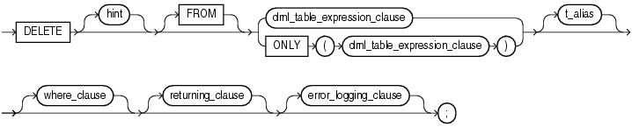

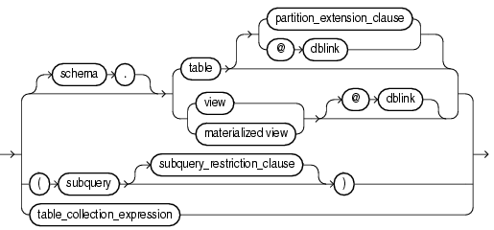
DELETE Statement Syntax Diagram (1)
Like WHERE clause
in SELECT statement
Notes:
Restrictions on the dml_table_expression_clause Clause
This clause is subject to the following restrictions:
* You cannot execute this statement if table or the base or master table of view or materialized_view contains any domain indexes marked IN_PROGRESS or FAILED.
* You cannot insert into a partition if any affected index partitions are marked UNUSABLE.
* You cannot specify the ORDER BY clause in the subquery of the DML_table_expression_clause.
* You cannot delete from a view except through INSTEAD OF triggers if the defining query of the view contains one of the following constructs:
A set operator
A DISTINCT operator
An aggregate or analytic function
A GROUP BY, ORDER BY, MODEL, CONNECT BY, or START WITH clause
A collection expression in a SELECT list
A subquery in a SELECT list
A subquery designated WITH READ ONLY
Joins, with some exceptions, as documented in Oracle Database Administrator's Guide
If you specify an index, index partition, or index subpartition that has been marked UNUSABLE, then the DELETE statement will fail unless the SKIP_UNUSABLE_INDEXES initialization parameter has been set to true.

Slide 24
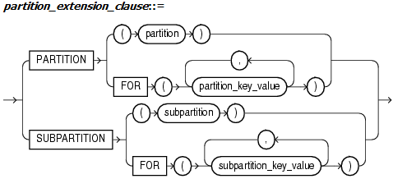
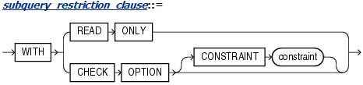

DELETE Statement Syntax Diagram (2)
For partitioned tables
PL/SQL extensions
Notes:
Deleting Rows from a Partition:
Example The following example removes rows from partition sales_q1_1998 of the sh.sales table:
DELETE FROM sales PARTITION (sales_q1_1998)
WHERE amount_sold > 1000;

Slide 25
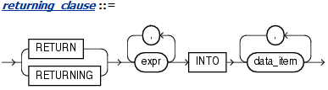
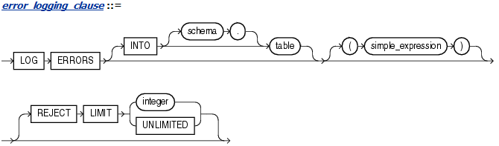
DELETE Statement Syntax Diagram (3)
PL/SQL extensions
Notes:
Using the RETURNING Clause:
Example The following example returns column salary from the deleted rows and stores the result in bind variable :bnd1. The bind variable must already have been declared.
DELETE FROM employees
WHERE job_id = 'SA_REP'
AND hire_date + TO_YMINTERVAL('01-00') < SYSDATE
RETURNING salary INTO :bnd1;

Slide 26
DELETE Statement Examples
DELETE FROM EMPLOYEES
WHERE JOB_ID = 'SA_REP' AND COMMISSION_PCT < .2;
DELETE FROM (SELECT * FROM EMPLOYEES)
WHERE JOB_ID = 'SA_REP' AND COMMISSION_PCT < .2;
DELETE FROM (
SELECT *
FROM EMPLOYEES
WHERE JOB_ID = 'SA_REP' AND COMMISSION_PCT < .2
);
DELETE FROM EMPLOYEES
WHERE JOB_ID IN (
SELECT JOB_ID
FROM EMPLOYEES
WHERE SALARY
= (SELECT MIN(SALARY) FROM EMPLOYEES)
);
Deleting from
inline views
Using
sub-queries
Notes:
DELETE FROM EMPLOYEES
WHERE JOB_ID = 'SA_REP'
AND COMMISSION_PCT < .2;
DELETE FROM (SELECT * FROM EMPLOYEES)
WHERE JOB_ID = 'SA_REP'
AND COMMISSION_PCT < .2;
DELETE FROM (
SELECT * FROM EMPLOYEES
WHERE JOB_ID = 'SA_REP'
AND COMMISSION_PCT < .2
);
DELETE FROM EMPLOYEES
WHERE JOB_ID IN (
SELECT JOB_ID
FROM EMPLOYEES
WHERE SALARY = (SELECT MIN(SALARY) FROM EMPLOYEES)
);
====
Deleting Rows from a Partition:
Example The following example removes rows from partition sales_q1_1998 of the sh.sales table:
DELETE FROM sales PARTITION (sales_q1_1998)
WHERE amount_sold > 1000;
Using the RETURNING Clause:
Example The following example returns column salary from the deleted rows and stores the result in bind variable :bnd1. The bind variable must already have been declared.
DELETE FROM employees
WHERE job_id = 'SA_REP'
AND hire_date + TO_YMINTERVAL('01-00') < SYSDATE
RETURNING salary INTO :bnd1;

Slide 27
Updatable Views Prerequisites
The updatable view must not contain any of the following constructs:
A set operator
A DISTINCT operator
An aggregate or analytic function
A GROUP BY, ORDER BY, MODEL, CONNECT BY, or START WITH clause
A collection expression in a SELECT list
A subquery designated WITH READ ONLY
Joins, with some exceptions, as documented in Oracle DB Administrator's Guide
Inline join view will be updatable if all of the following conditions are true:
The DML statement must affect only one table underlying the join.
For an INSERT statement: all columns into which values are inserted must come from a key-preserved table.
For an UPDATE statement: all columns updated must be extracted from a key-preserved table.
For a DELETE statement: key-preserved table should present into view; if the join results in more than one key-preserved table, then Oracle Database deletes from the first table named in the FROM clause.
Notes:
Updating a Join View
http://docs.oracle.com/cd/E11882_01/server.112/e25494/views001.htm#i1006232
An updatable join view (also referred to as a modifiable join view) is a view that contains multiple tables in the top-level FROM clause of the SELECTstatement, and is not restricted by the WITH READ ONLY clause.
General Rule
Any INSERT, UPDATE, or DELETE operation on a join view can modify only one underlying base table at a time.
UPDATE Rule
All updatable columns of a join view must map to columns of a key-preserved table.
If the view is defined with the WITH CHECK OPTION clause, then all join columns and all columns of repeated tables are not updatable.
DELETE Rule
Rows from a join view can be deleted as long as there is exactly one key-preserved table in the join.
The key preserved table can be repeated in the FROM clause.
If the view is defined with the WITH CHECK OPTION clause and the key preserved table is repeated, then the rows cannot be deleted from the view.
INSERT Rule
An INSERT statement must not explicitly or implicitly refer to the columns of a non-key-preserved table.
If the join view is defined with the WITH CHECK OPTION clause, INSERT statements are not permitted.
(“WITH CHECK OPTION” does not affect inline views)

Slide 28
Remove empty departments
DELETE (
SELECT D.*
FROM DEPARTMENTS D
WHERE 0 = (
SELECT COUNT(*)
FROM EMPLOYEES
WHERE DEPARTMENT_ID = D.DEPARTMENT_ID
)
);
-- ORA-01752: cannot delete from view without
-- exactly one key-preserved table
DELETE (
SELECT D.DEPARTMENT_ID
FROM DEPARTMENTS D LEFT JOIN EMPLOYEES E
ON D.DEPARTMENT_ID = E.DEPARTMENT_ID
WHERE E.EMPLOYEE_ID IS NULL
);
Notes:
The first one is working, but slow (correlated query with aggregation). The cost of SELECT is 17! (DELETE costs 15)
The second SELECT has cost 4, but it’s impossible to determine key-preserve table.

Slide 29
Remove empty departments
DELETE (
SELECT D.*
FROM DEPARTMENTS D
WHERE NOT EXISTS (
SELECT 1
FROM EMPLOYEES
WHERE DEPARTMENT_ID = D.DEPARTMENT_ID)
);
DELETE FROM DEPARTMENTS D
WHERE NOT EXISTS (
SELECT 1
FROM EMPLOYEES
WHERE DEPARTMENT_ID = D.DEPARTMENT_ID
);
Notes:
SELECT cost is 3 (DELETE cost is 1)

Slide 30
ORACLE SQL INTODUCTION
MTN.NIX.07
Questions & Answers
Siarhei Kandrashevich
Senior DB Developer

